Slide 1
Gene Expression Data Analysis
Matthew Palmgren

Slide 2
GTEx Portal
The Genotype Tissue Expression (GTEx) project is a collection of data sets that provide RNA-Seq gene expression data for various tissues collected from donors. Along with this data comes important meta data information such as Age, Sex, and Death Hardy Values. GTEx is publicly available and has been contributing to our understanding of the human genome.

Slide 3
Median Gene Expression & Hippocampus Tissue Data
Median Gene Expression Across Various Tissue Types
This data set was chosen because of its simplified yet comprehensive nature that allows for analysis gene expression profiles across various tissue types.
Gene Expression in Hippocampus Tissue with Subject Specific Meta Data
This data set was chosen to look at trends in gene expression across different factors such as Age and Sex

Slide 4
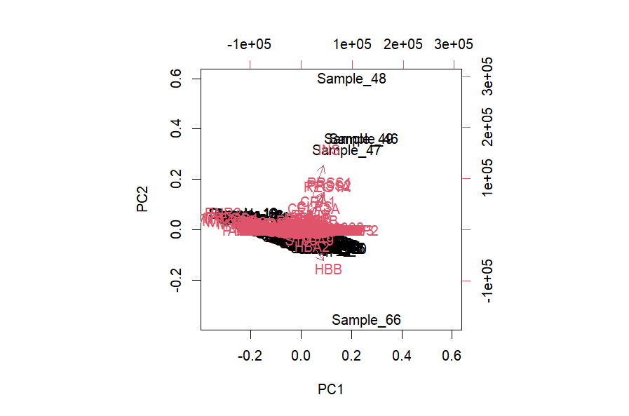
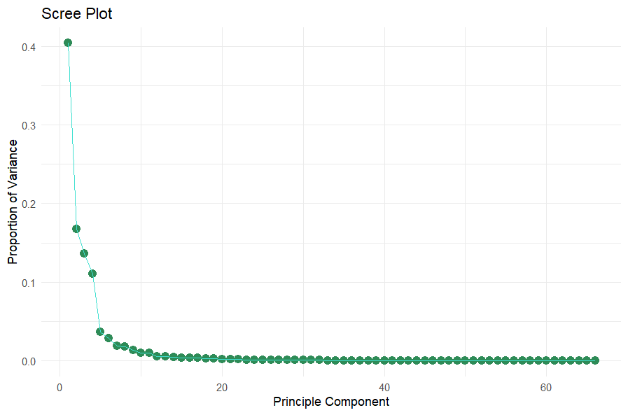
Median Gene Expression Data Structure
PCA Analysis:
PC1 – 40.4%
PC2 – 16.7%
PC3 – 13.6%
PC4 – 11.03%

Slide 5
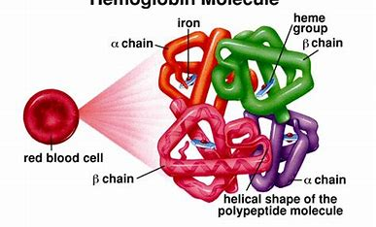
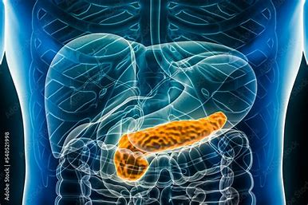
Top 10 PCA Loadings
Top 10 genes driving variation include…
PRSS1
HBB
INS
PRSS2
REG1A
CPA1
CLPS
CELA3A
HBA2
PNLIP

Slide 6
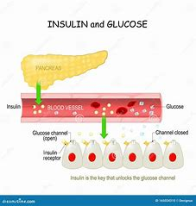
Summary Median gene Expression Data summary statistics
Tissue/sample with the lowest number of genes expressed
- Whole Blood
Tissue with the greatest range in gene expression
- Pancreas Islets
*INS expression

Slide 7
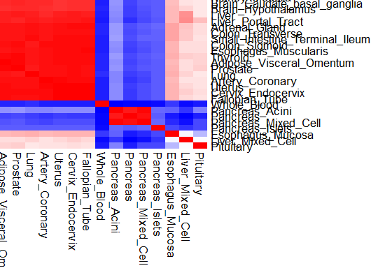
Correlation Heatmap of tissue Types by Gene Expression

Slide 8
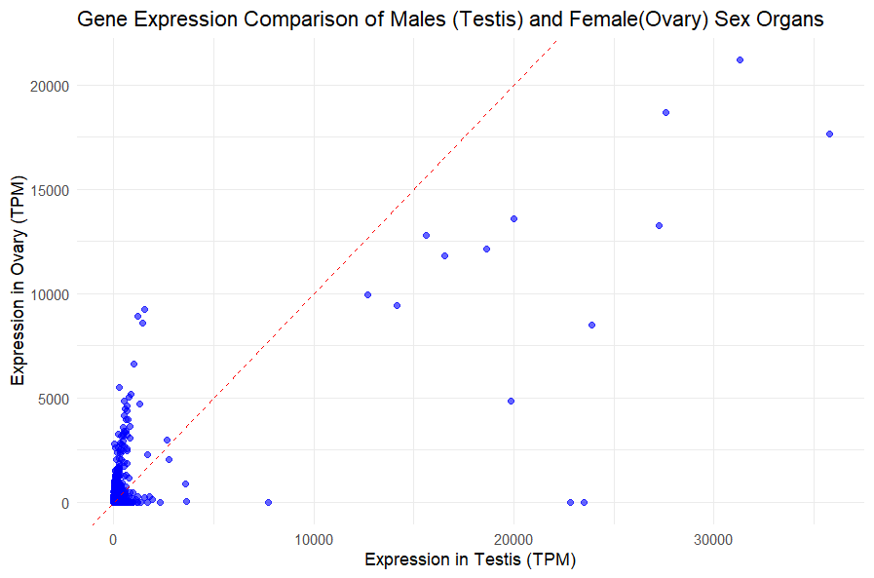


Gene Expression comparison in Sex organs
Comparison between Testis and Ovary Gene Expression
Both tissue hold importance in human reproduction and so the goal was to analyze whether they are more similar or more different
Calculated Correlation Coefficient
(ρ = 0.775753)

Slide 9
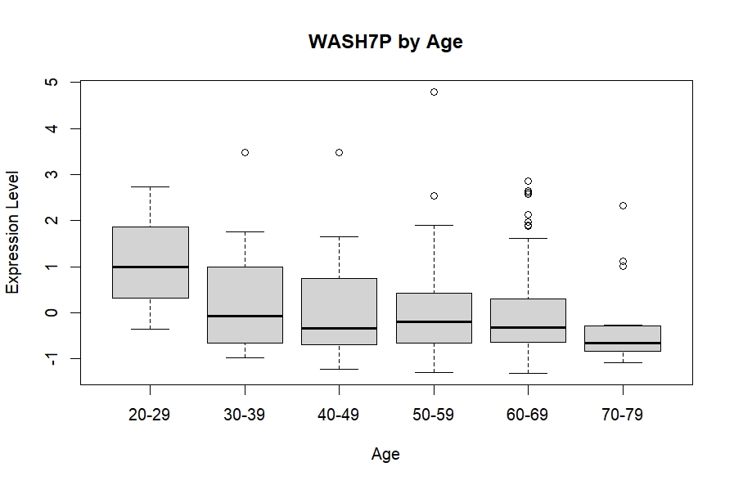
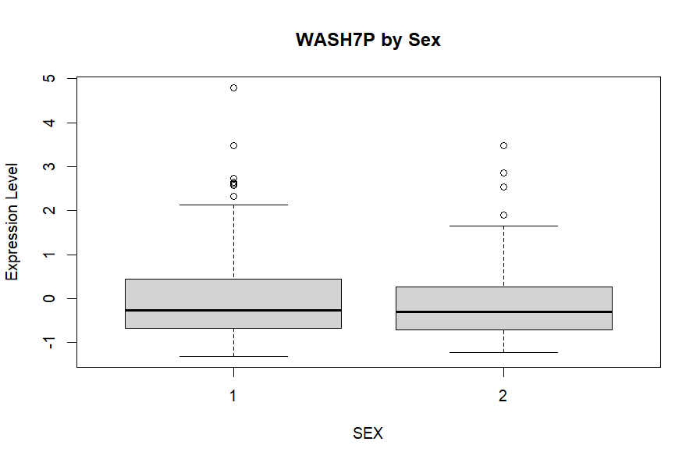
Hippocampus tissue data structure
WASH7P is the most widely expressed gene in the data set
Expecting no significant variation
Linear Regression
60-69 (p=0.0425) and 70-79 (p=0.0291)
Multiple R^2=0.03076, Adjusted R^2= 0.008218
(model) p = 0.2388
T-test
p = 0.7948

Slide 10
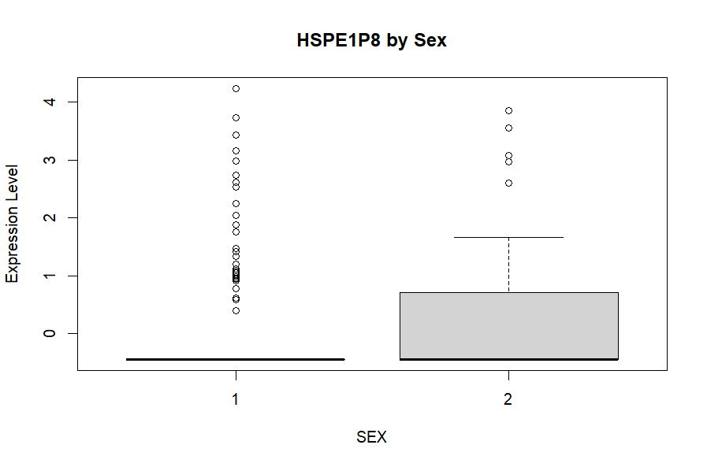
Heat Shock Proteins (HSP)
HSPs are proteins found in the hippocampus that respond to stressful stimuli. Some studies have showed that sex hormone levels can affect HSP expression
15 HSP genes were identified from the data set, and only HSPE1P8 showed any real difference in expression level based on box plot visuals
Linear Regression determined did not find the difference to be significant (Pr(|>t|)=0.169), but also was not a great fitting model.
Multiple R-squared: 0.008636, Adjusted R-squared: 0.004109

Slide 11
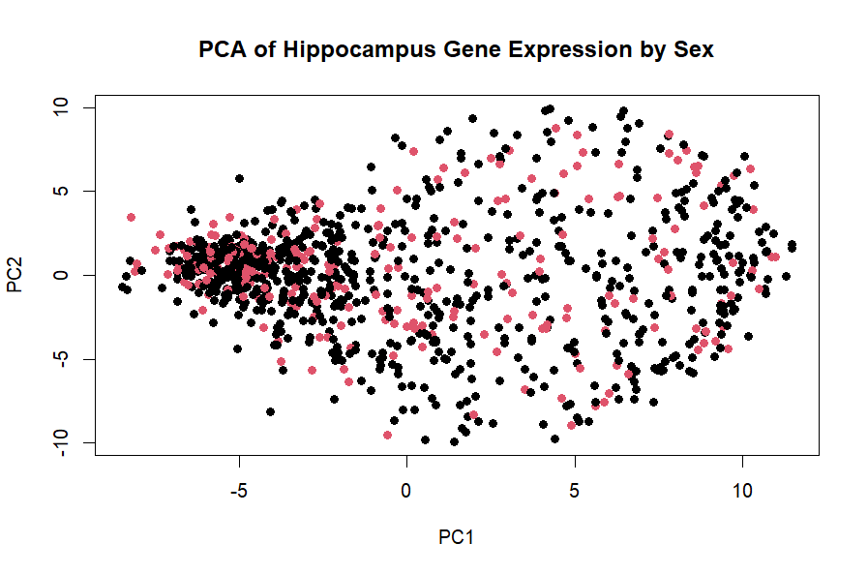
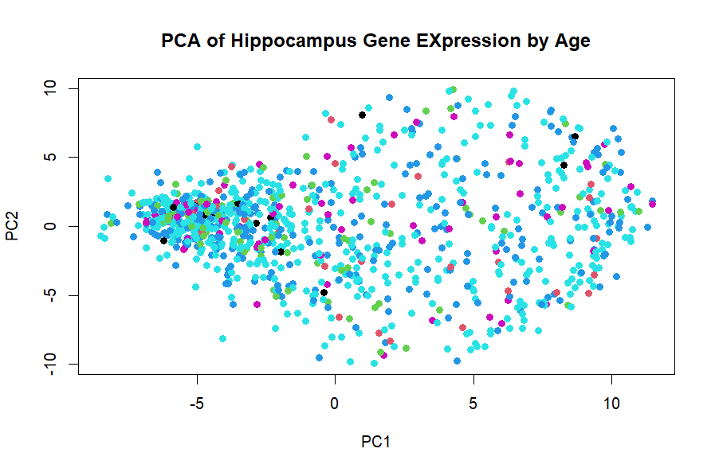
PCA for top 1000 most variable genes
PCA plots for both Age and Sex were created with the top 1000 most variable genes for hippocampus tissue donors
There appears to be a cluster of samples with similar gene expression profiles but it does not appear to be clustered by sex or by age

Slide 12
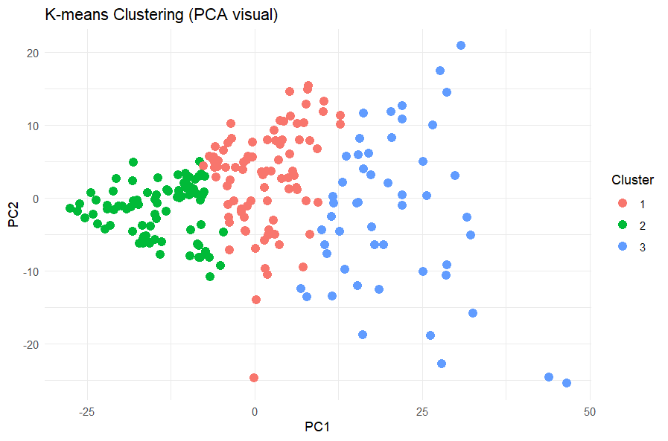
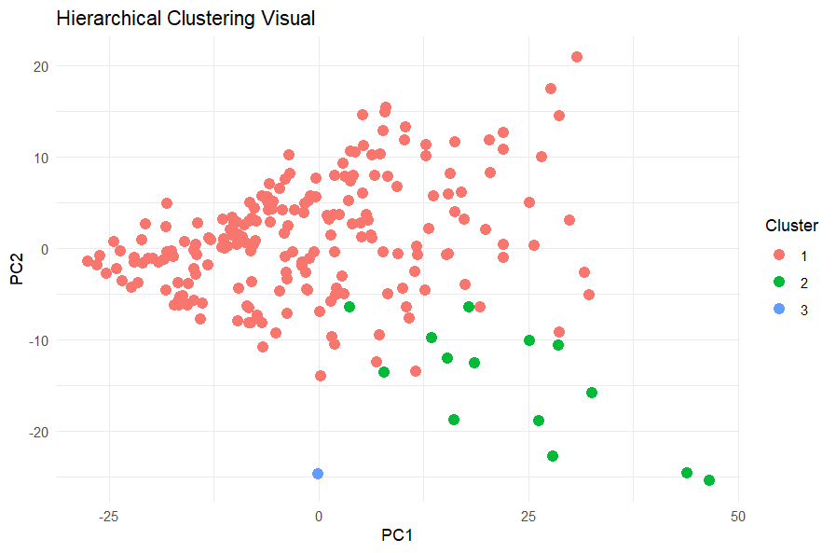
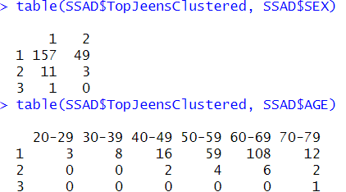
Unsupervised Learning
K-means clustering appears to show clusters are based on how spread-out samples are while hierarchical clustering shows a slight nested structure to the data. A data table of age and sex by cluster confirms no real variation based on the analyzed meta data.

Slide 13
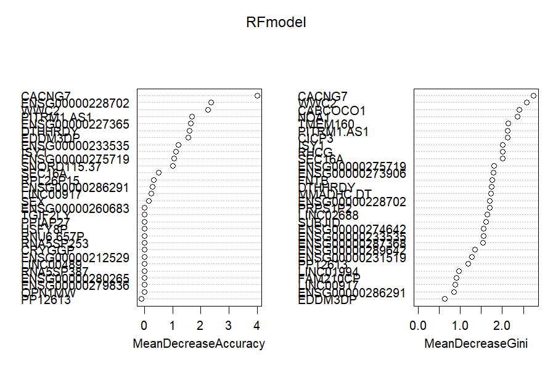
Classification Modeling – Random Forest
A Random Forest Classification model was run to try and see if Age could be predicted based on gene expression values
The model was trained with 100 random tissue samples , 50 random genes, and ntrees was set to 500
The model was able to predict age classification with ~50% accuracy
Variable Importance Plot shows CACNG7 and WWC2 to be the two genes that were overall most important for the model’s predictive capabilities

Slide 14
Limitations and Further Study
Further Study
Limitations
Analyze trends in mitochondrial genes versus nuclear genes
Take a deeper dive into gene expression across different pancreas tissue
Compare pancreas gene expression against whole blood gene expression
Time
Limited R Memory

Slide 15
THANK YOU!

